Slide 1
Ddi foundation
Update 2013

Slide 2
content
First 3 years
What did we work on?
Donate for free with DAN
New Programs and Manuals
Log on to web
DDI Outcome Project

Slide 3
First 3 years

Slide 4
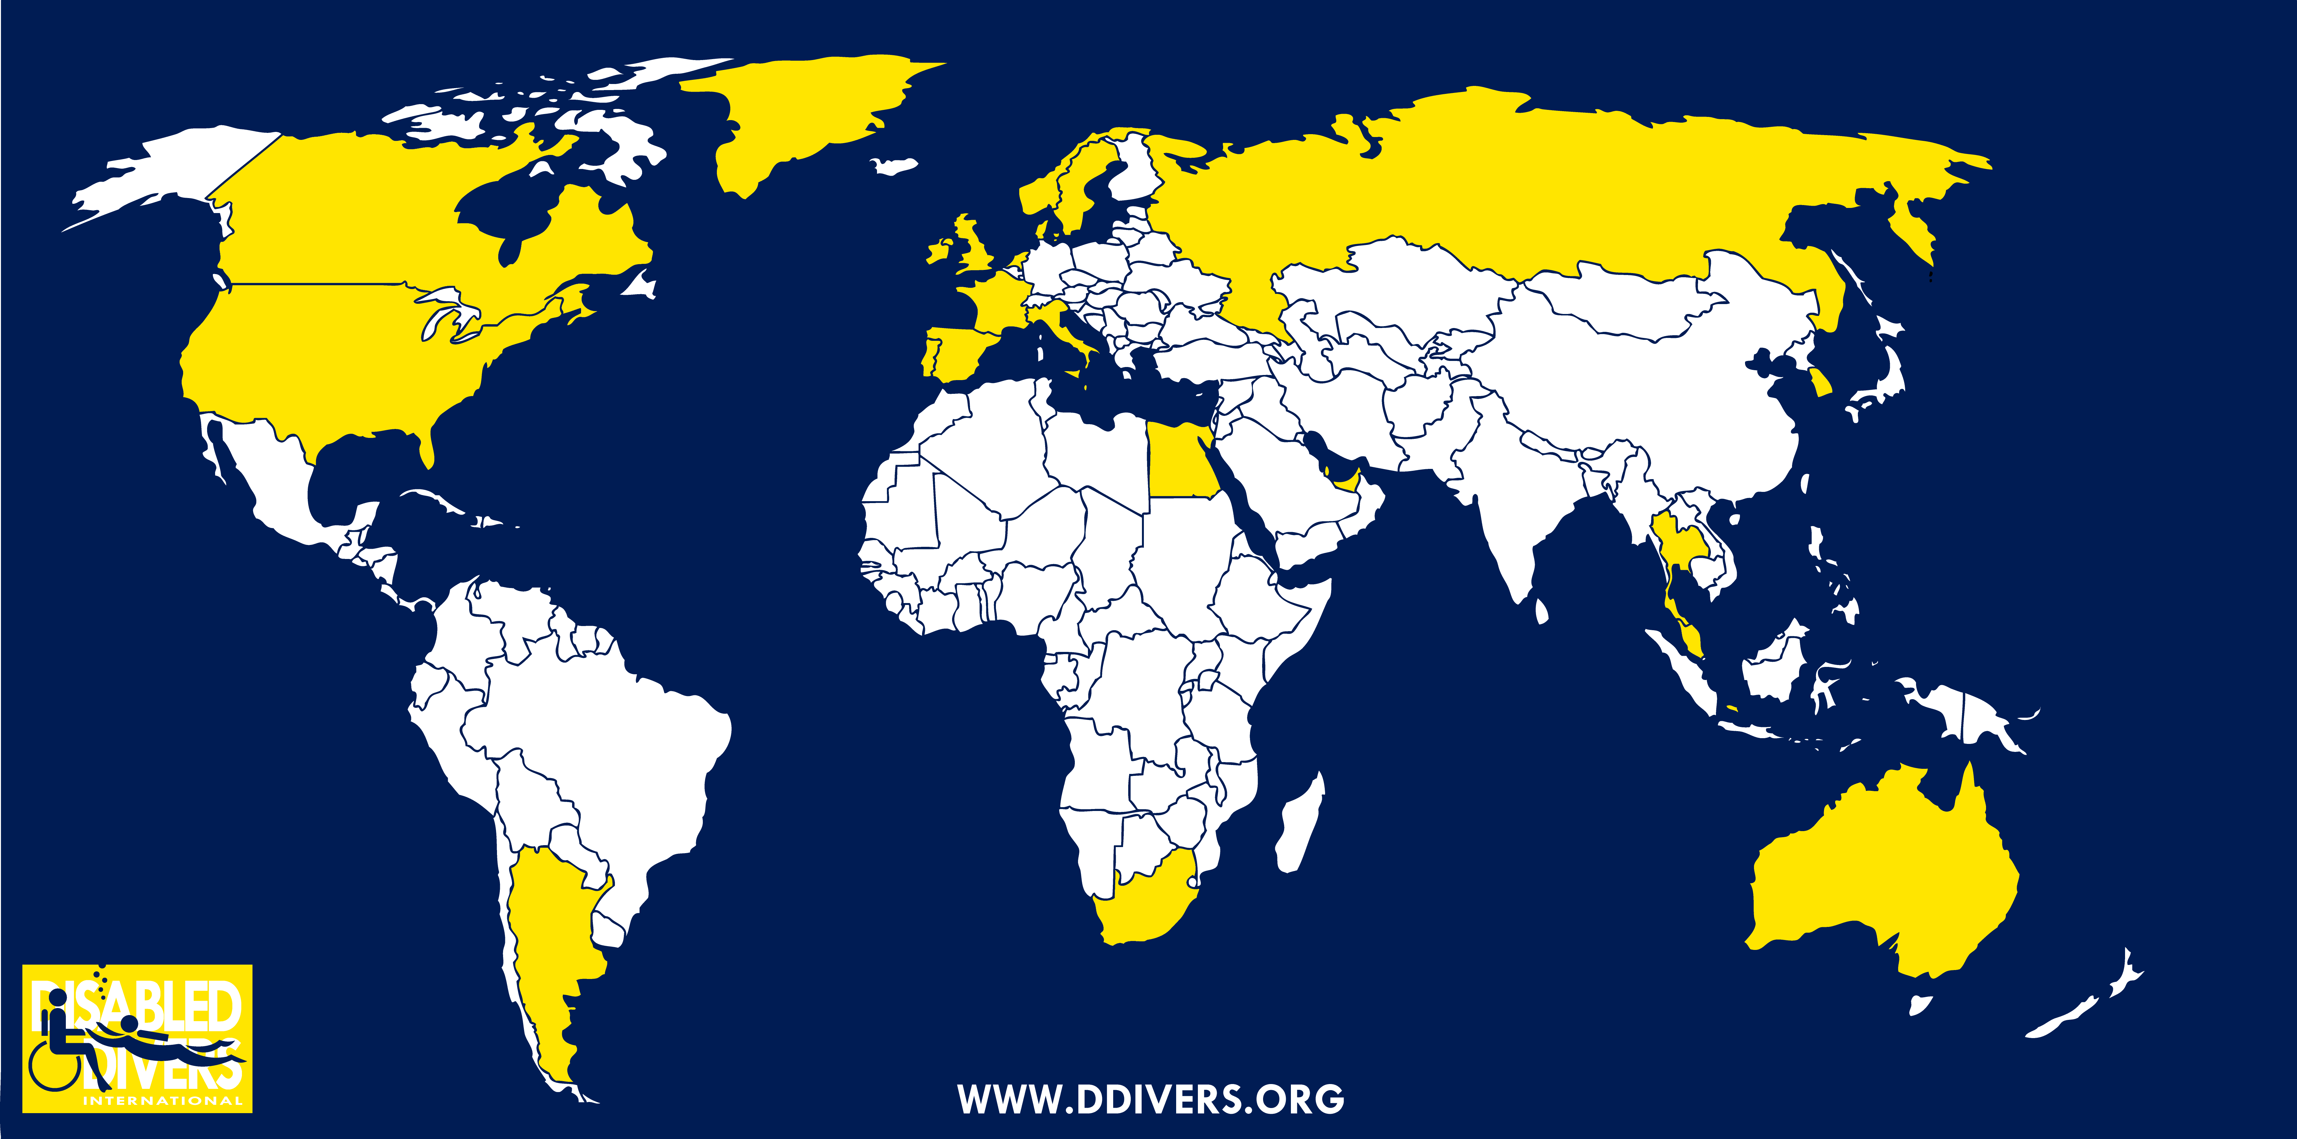
First 3 years
Establishing a new organisation
New and refreshing start
Many years of experience
Organisation; board of directors, volunteers, project teams
Establishing an office
Expanding the network
New Partners http://www.ddivers.org/partners
Branding

Slide 5
Donate for fRee witH dan

Slide 6
Donate for free with DAN
Divers Alert Network will award DDI a referral bonus when our partner link is used to purchase or renew your DAN insurance. Any such bonus will go directly towards the running of our non-profit organization and help keep prices as low as possible.
We encourage our members and supporters to use the DAN links available on our website www.ddivers.org under Donate. By doing so you are donating to DDI, without any cost to you. We appreciate the support.
DDI is a DAN corporate partner, our partner ID is "346432”, remember to write this when you renew with DAN

Slide 7
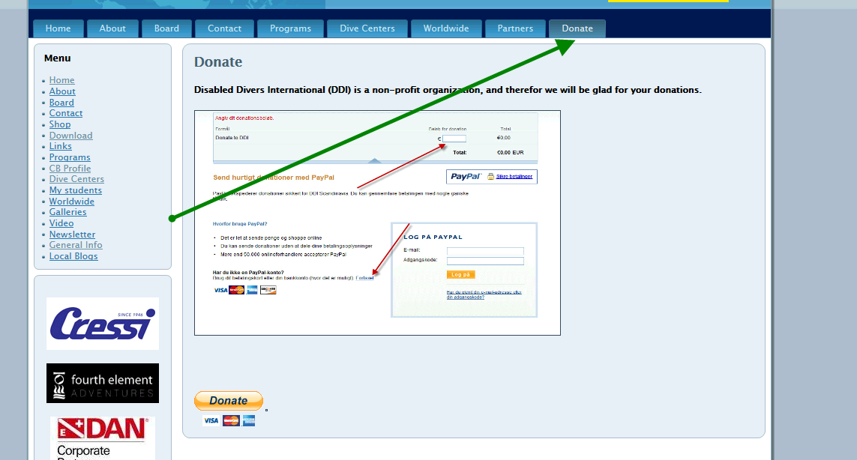
Donate to ddi
Disabled Divers International (DDI) is a non-profit organization, we appreciate all donations.
(Now everyone has the chance to donate money to DDI)
new Donate button on the website.

Slide 8
New Programs

Slide 9
Rehab diver – Dolphin Diver
Rehab Diver
The DDI Rehab Diver Specialty course provides candidates with the necessary knowledge and skills required to safely and effectively administer exercise therapy in a confined water environment
Prerequisites
Be a licensed DDI Assistant Diver (or license pending), or equivalent – and submit a
copy of proof.
Be a licensed therapist of minimum B.Sc degree (or equivalent – that is minimum three
year full time college/university program) – and submit a copy of proof.
Dolphin Diver
The DDI Dolphin Diver course provides children with the necessary knowledge and skills required to be in pool water environment.
Prerequisites
Must be 12 years old
Submit a copy of a medical examination stating that the individual is fit for diving.
The examination must be conducted within the past twelve months.
Manual to Surface Assistant.

Slide 10
Log on to web

Slide 11
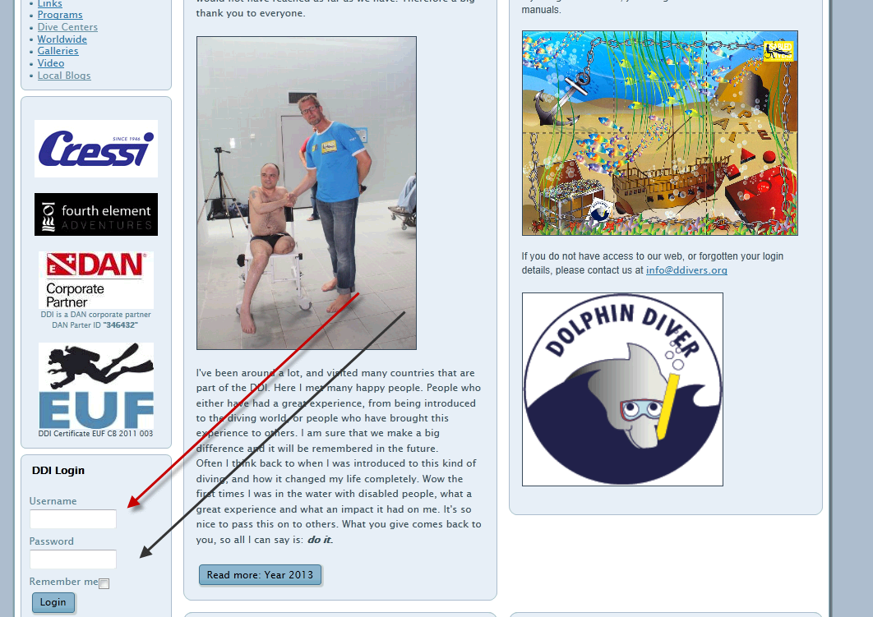
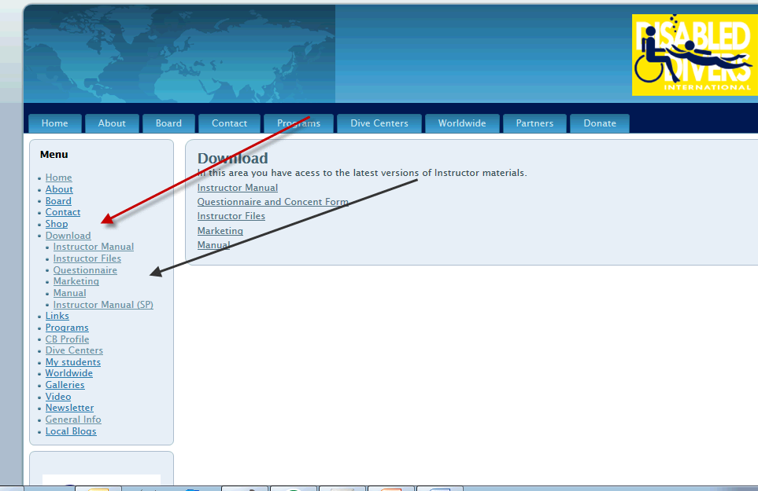
Log on to web
www.ddivers.org

Slide 12
DDI Outcome project

Slide 13
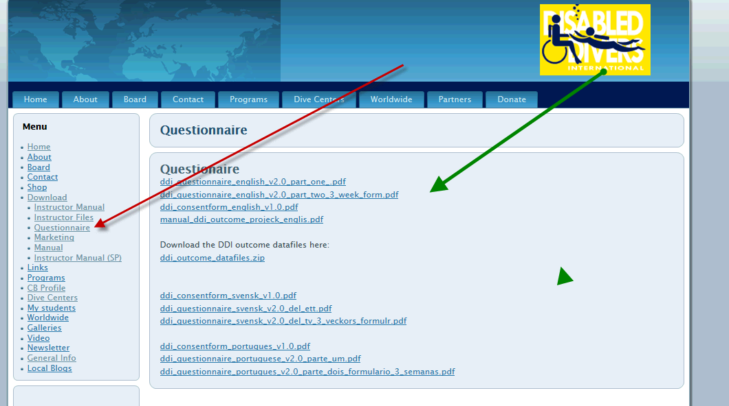
DDI outcome Project
Very important for DDI and the future of diving as therapy
Measure how a dive experience might change a participant's view of his/her own abilities
To be taken seriously by the medical community we need to:
Collect data systematically
Use a validated outcome questionnaire (available in many languages)
Measure before – and some time after the dive experience (3 weeks)
Keep it participant voluntary
Have written consent
Ensure anonymity
Follow the User Manual!
You can play an important part
in this new part of medicine!

